Slide 1
Suffix Trees
Made By :- Sujeet Narayan Kamble
Roll No :- 200101097

Slide 2
What is a suffix tree?
A suffix tree is a data structure used for efficient string processing.
It is essentially a trie-based data structure that stores all the suffixes of a given string in a compressed form
It can be used for a variety of string operations, such as substring searches, pattern matching, and longest common substring and subsequence finding.
The space complexity for a normal trie is O(N²) while for suffix tree is O(N)

Slide 3
Insertion in a suffix tree:
We add all suffix of a string into the suffix tree.
Each edge has a label and each node contain pointers to all character set.
We find if pointer pointing to first character of suffix to be added is null and if it is then we spawn an edge from first character of suffix to a new node, and give label to the edge as the suffix.
If the pointer is not null then we split the nodes corresponding to longest common suffix.

Slide 4
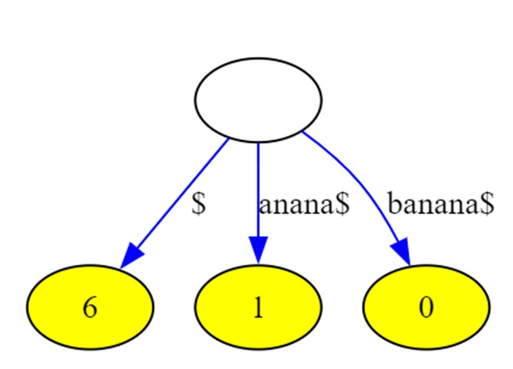
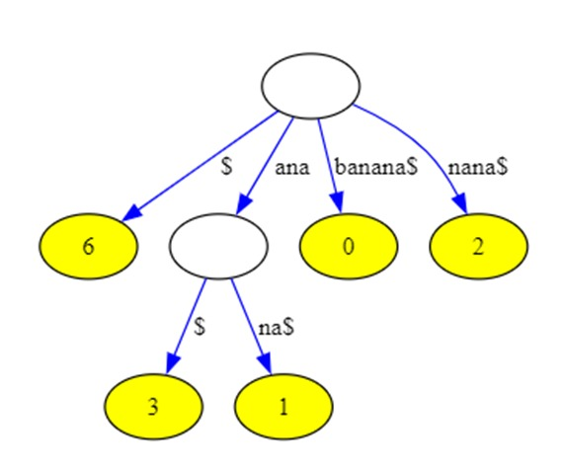
This is the case when a prefix of suffix is common

Slide 5
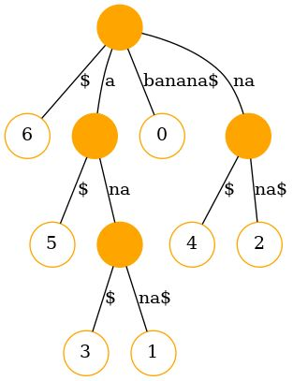
Final suffix tree for the string “banana”
0 | 1 | 2 | 3 | 4 | 5 | 6
b | a | n | a | n | a | $

Slide 6
Search for a substring:
To search for a substring s , we start from root node and follow the pointer path whilst comparing longest common prefix.
We return true if the at some level, the remaining suffix of string to be searched matches with some prefix of the label
Else we return false.

Slide 7
Example of search:
We search for substring “anan”.
We start from root and go to the node pointed by a, we match prefix of edge label with some prefix of “anan”.In this case a is matched, so remaining part is “nan”.
We now jump to node whose edge label is “na”
Now we match prefix of edge label “na” to prefix of remaining substring i.e. “na” of “nan”.
Now remaining part is “n” which would be compared to edge label and n is matched with prefix “n” of edge label “na”.

